Slide 1


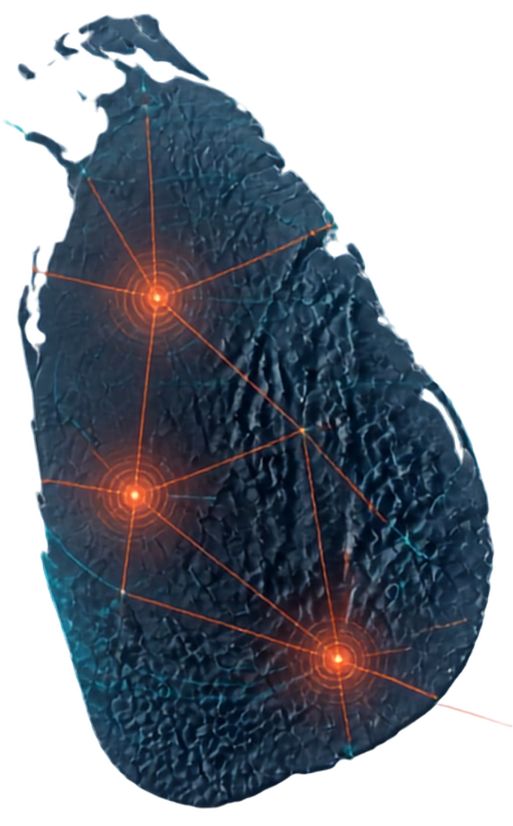
IDMERS:
Integrated Flood and Landslide Risk Assessment and Response System for Sri Lanka
Predict. Warn. Respond.
Save Lives and Build a Safer Country
PROJECT ID: J26-IT-334

Slide 2

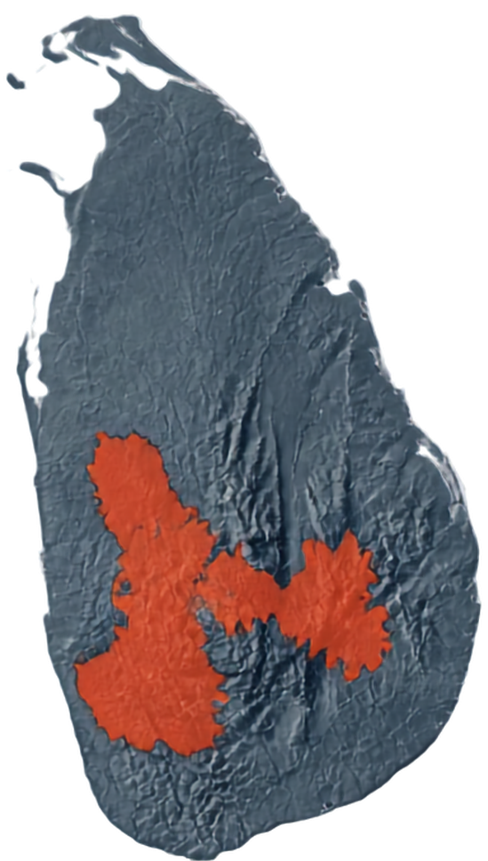




Recurring Risks. Real Impact.
Floods and landslides continue to devastate communities across Sri Lanka.
Loss of life, infrastructure damage, transport disruption, and significant economic losses
Kegalle
Nuwara Eliya
High-risk areas: Ratnapura, Kegalle, Badulla, Nuwara Eliya
Driven by monsoon rainfall, urbanization, deforestation, land use changes, and climate variability
Ratnapura
Badulla
Current warning systems are separate, hazard-specific, and reactive

Slide 3
















One System.
Smarter Response.
An integrated, AI-driven system for flood and landslide risk
Four components working together from prediction to response
Timely, explainable, inclusive alerts and prioritized actions for Sri Lanka
PREDICTION
ASSESSMENT
DECISION SUPPORT
RESPONSE
AI-driven models forecast heavy rainfall and assess flood and landslide risk across Sri Lanka
Estimate potential impacts on people, infrastructure, and livelihoods
Generate explainable risk insights and prioritized response recommendations
Coordinate agencies and mobilize resources for rapid, effective emergency actions
EARLY ALERTS SAVE LIVES

Slide 4



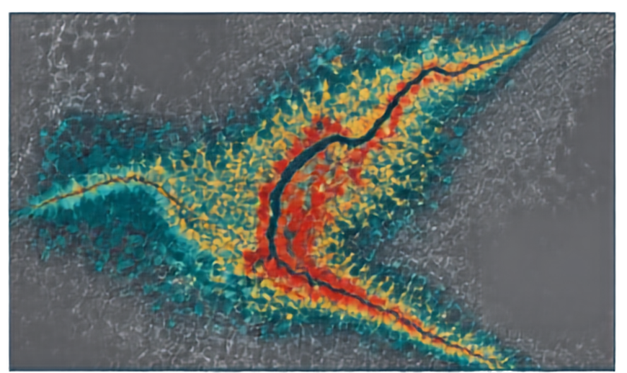

















Component 1
Flood Severity Assessment & Mapping
MULTI-SOURCE DATA INPUTS
PROCESSING & ANALYTICS
DYNAMIC FLOOD SEVERITY MAP
Rainfall
Preprocess and fuse geospatial data
River
levels
AI/ML models with explainable risk factors
Satellite observations
Assess flood extent and severity
Low
Medium
Terrain &
land use
High
Estimate affected population, buildings and infrastructure
Historical floods & population
Supports evacuation planning
Enables resource prioritization
Guides decision-making in real time
Actionable insight for response

Slide 5




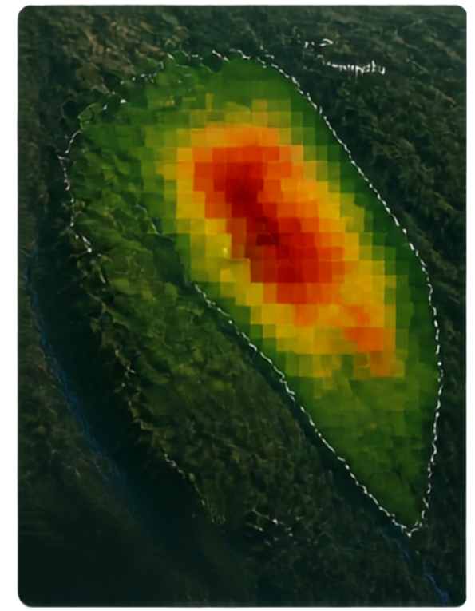









COMPONENT 2
Probabilistic Landslide Assessment & Forecasting
Machine learning and explainability with accessible alerts
Landslide Risk Alert
Landslide Severity Index
HIGH RISK
Real-time landslide probability from provincial to village scale
EXPLAINABILITY (SHAP)
Top factor contributions
Explainable AI reveals the key environmental and human drivers
Rainfall intensity
+0.38
Soil saturation
+0.27
Slope gradient
+0.19
Elevation
-0.12
Nuwara Eliya
Land cover (forest)
-0.99
Drainage condition
-0.77
Slope cutting
-0.06
Accessible Web-GIS and 3D maps with Sinhala/Tamil dual-language alerts
Probability
Time
Risk level
Nawalapitiya
0.78
NOW
HIGH
Landscape probability
Powered by Random Forest/XGBoost, PostGIS, Leaflet/MapLibre, WebGL
Low
High
Evacuation Immediatly

Slide 6







Component 3
Flood and Landslide Risk
Human Impact & Decision Support.
Population Density
Vulnerability Factors
Brings hazard data together with population and social vulnerability
Infrastructure & Access
Considers critical infrastructure, access, history, uncertainty, and temporal overlap
Combined Risk Priority
Models joint and cascade risks for deeper insight
Produces clear priority scores for fair, explainable decisions
HIGH PRIORITY
MEDIUM PRIORITY
LOW PRIORITY
ALERT
ALERT
ADVISORY
Delivers graded alerts, actions, and prioritized response zones
Immediate Action Recommended
Prepare and Monitor
Stay Informed

Slide 7






















Component 4 Emergency Response & Resource Coordination
Real-time resource-aware dispatch and routing innovations
INNOVATION
Boats
Real-time
resource-aware dispatch
Dual-route
Priority
Alerts
Live Resource
Check
Resource Allocation
Hazard-aware Routing
Dispatch & Tracking
optimization
via standardized API
assets, shelters
and supplies
evacuation and rescue routes
multi-channel alerts, arrivals, occupancy, resource use
inventory +
dispatch constraints
Scarcity-based queuing
Ambulances
Supplies
Multi-channel
Shelters
localized dispatch

Slide 8



















System Architecture.
One Integrated Workflow. End-to-End Impact.
FLOOD MODULE
DATA INPUTS
DATA INTEGRATION & GIS LAYERS
Model & assess flood risk
JOINT RISK & IMPACT PRIORITIZATION
OUTPUTS
Multi-source data & live telemetry
API GATEWAY
Dashboards Web-GIS Alerts Reports
Ingest Process GIS layers
Combine hazards Assess impact Prioritize areas
Secure APIs Data services
LANDSLIDE MODULE
Model & assess landslide risk
RESOURCE COORDINATION
Routing • Dispatch • Field updates
CITIZENS
DMC & AUTHORITIES
RESPONDERS & PARTNERS
Information Alerts Guidance
Situational awareness Decision support Coordination
Tasking Dispatch
Field operations

Slide 9








Team and Supervisors.
OUR PROJECT TEAM
ACADEMIC GUIDANCE
Sinhalagoda S.A.U.R.A.V (IT23280892)
Flood risk prediction & mapping
Dr. Kapila Dissanayaka
Bagya R M S (IT23394124)
Supervisor
ML landslide forecasting
Prathibhani Y.L.O.L (IT23317512)
Mr. Uchira Wickramarthne
Human impact & decision support
Co-Supervisor
Palihena M.B (IT23411562)
Emergency response & resource coordination
PROJECT ID
PROJECT TITLE
J26-IT-334
IDMERS: Integrated Disaster Management and Early Warning System

Slide 10

Thank You
Predict. Warn. Respond.
Strengthening communities
with trusted risk intelligence and
coordinated action.
Let’s work together.
Connect with us to explore partnerships,
share data, and build a safer Sri Lanka.
NBRO LIRIS | ReliefWeb/OCHA Sri Lanka floods & landslides | Dept. Meteorology Sri Lanka | DMC flood warning
UNDRR Sendai Framework | Palliyaguru et al. (ICTer 2020) | Atthanayake et al. (SLAAI-ICAI 2025)

